Slide 1


9th October 2026
BLACKTHORNS NEWSLETTER
🍂 It’s hard to believe how quickly the term is moving, and with the cooler mornings and crisp leaves, we are certainly feeling the arrival of autumn at Blackthorns! It has been another busy and happy fortnight, with so many examples of our school community coming together to support, encourage and celebrate our children. I am incredibly proud of the positive spirit across our school, and it is wonderful to see children, staff, families and our wider community playing such an important part in school life.
🌟 Our Reception children have made a fantastic start to life at Blackthorns and have settled in so well. They are already really enjoying their phonics sessions, enthusiastically practising their sounds, using Fred Talk and beginning to blend sounds together to read words. It has been lovely to see their confidence growing, and we are so pleased to have them as part of our Blackthorns family! 📚
🏕️ We would like to wish our Year 5 children lots of luck for their exciting two-night residential at Bowles next week! They have a great programme of activities ahead of them, including a ropes course, skiing, raft building, orienteering, archery and climbing. We are sure they will have an amazing time, challenge themselves, make wonderful memories and enjoy spending time together as a class. A huge thank you to Miss Wilding, Miss Clay, Mrs Piner and Miss Renfree for giving up their time to accompany the children and make this special experience possible. We hope you all have a fantastic adventure! 🌟

Slide 2
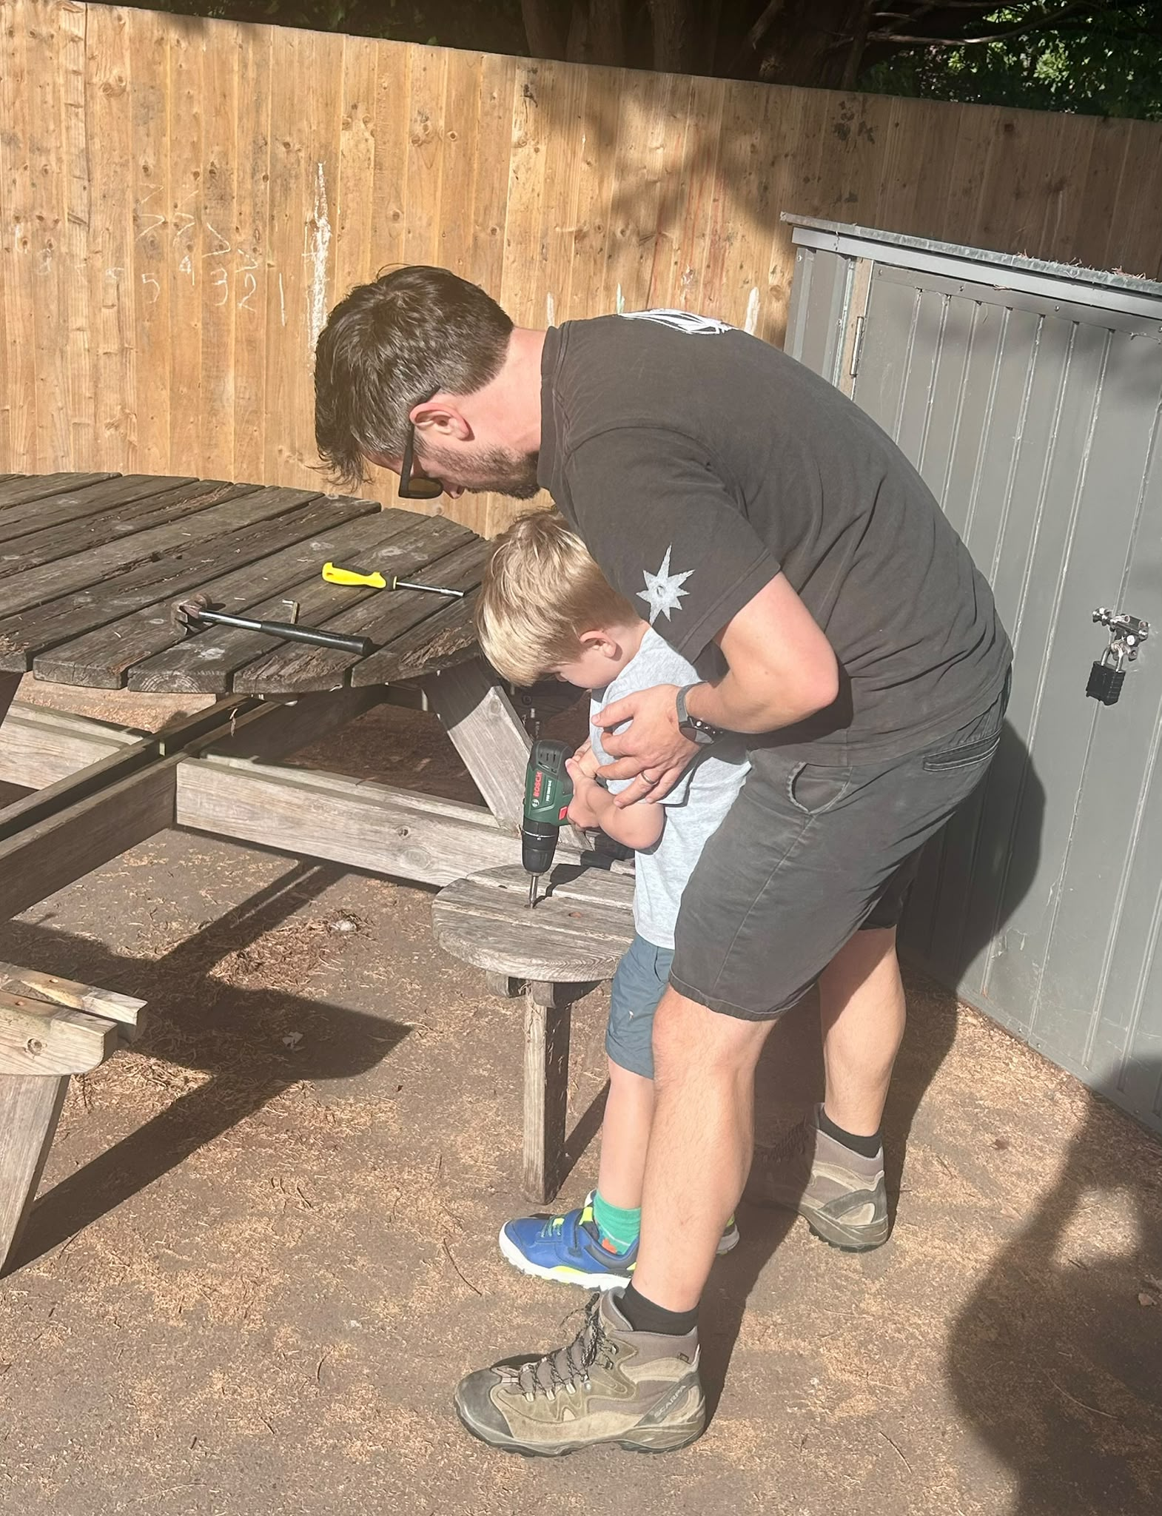
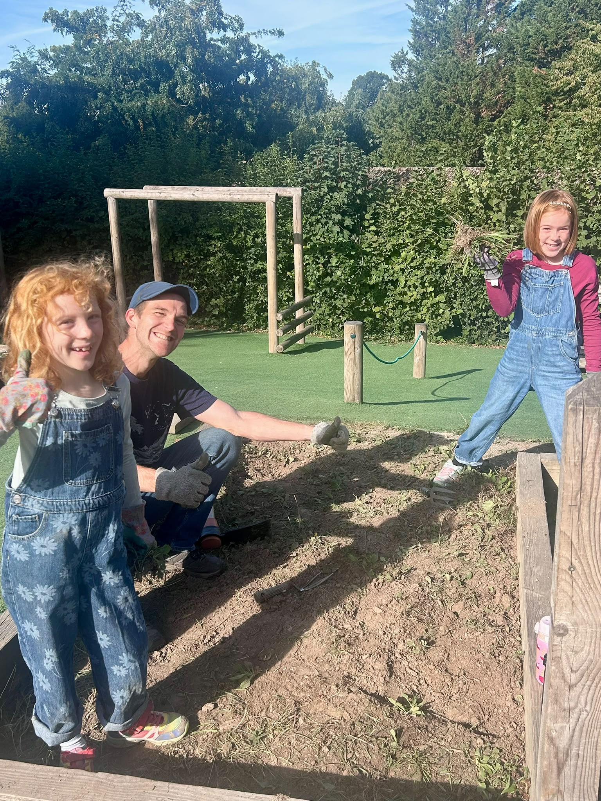
A huge thank you to those who gave up their time to support the Love Your School Day on Saturday 26th September. It was great to see so many parents, carers and children (30 adults and 21 children on the day) working together to spruce up the site and I hope everybody agrees that with fence staining, garden tidying, weeding beds etc. we've made a big impact in just one day! A couple of views from those that attended:
‘It was such a lovely few hours and just magic to see all the progress’
‘I love these kind of days where the local community pull together for the common good.’
We'd also like to extend our thanks to the invisible workers who covered childcare or other commitments in order to free up those who were with us on Saturday.
Thanks also to those of you who were able to donate plants, paint, stain and lend tools. We were particularly well supported by Share Haywards Heath - the local 'library of things' which lent us over 20 tools for the day with no charge to the school. If you're ever looking to borrow something do check out their website as it's a very easy and affordable way to hire what can otherwise be expensive equipment: https://sharehh.lend-engine.com/
There is more to be done and we're planning another event like this in 2027. If you want to help please email Bob Baker Chair of the Local Governing Body at b.baker@blackthornsprimaryacademy.org.uk

Slide 3
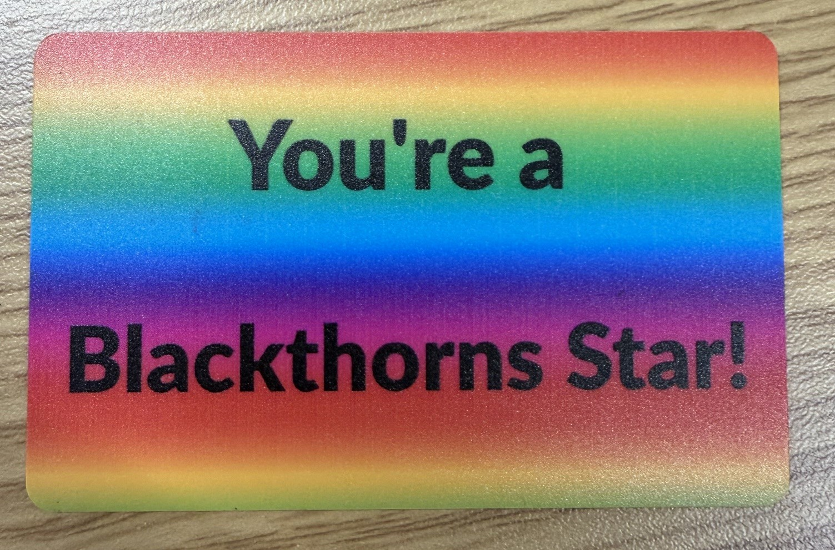
Every Day Counts!
Being in school every day helps children develop positive routines, grow in confidence and feel connected to their classmates and teachers. Missing school can mean missing important learning and the experiences that help children thrive. We understand that children may occasionally be unwell, but we encourage all families to make attendance a priority and help their children enjoy the full range of opportunities that life at Blackthorns has to offer. Thank you for your continued support!
🌟 Blackthorns Stars!
Each member of staff has been given a set of Blackthorns Star certificards, with the staff member’s name on the back. Throughout the week, staff will award these to children who are going above and beyond and really demonstrating our school values. To ensure we recognise children across the whole school, staff cannot give a certificard to a child in their own class! Every Friday, the children who have received a certificard will be celebrated in our Celebration Assembly. We can’t wait to see all the wonderful examples of our children being Blackthorns Stars! ⭐

Slide 4
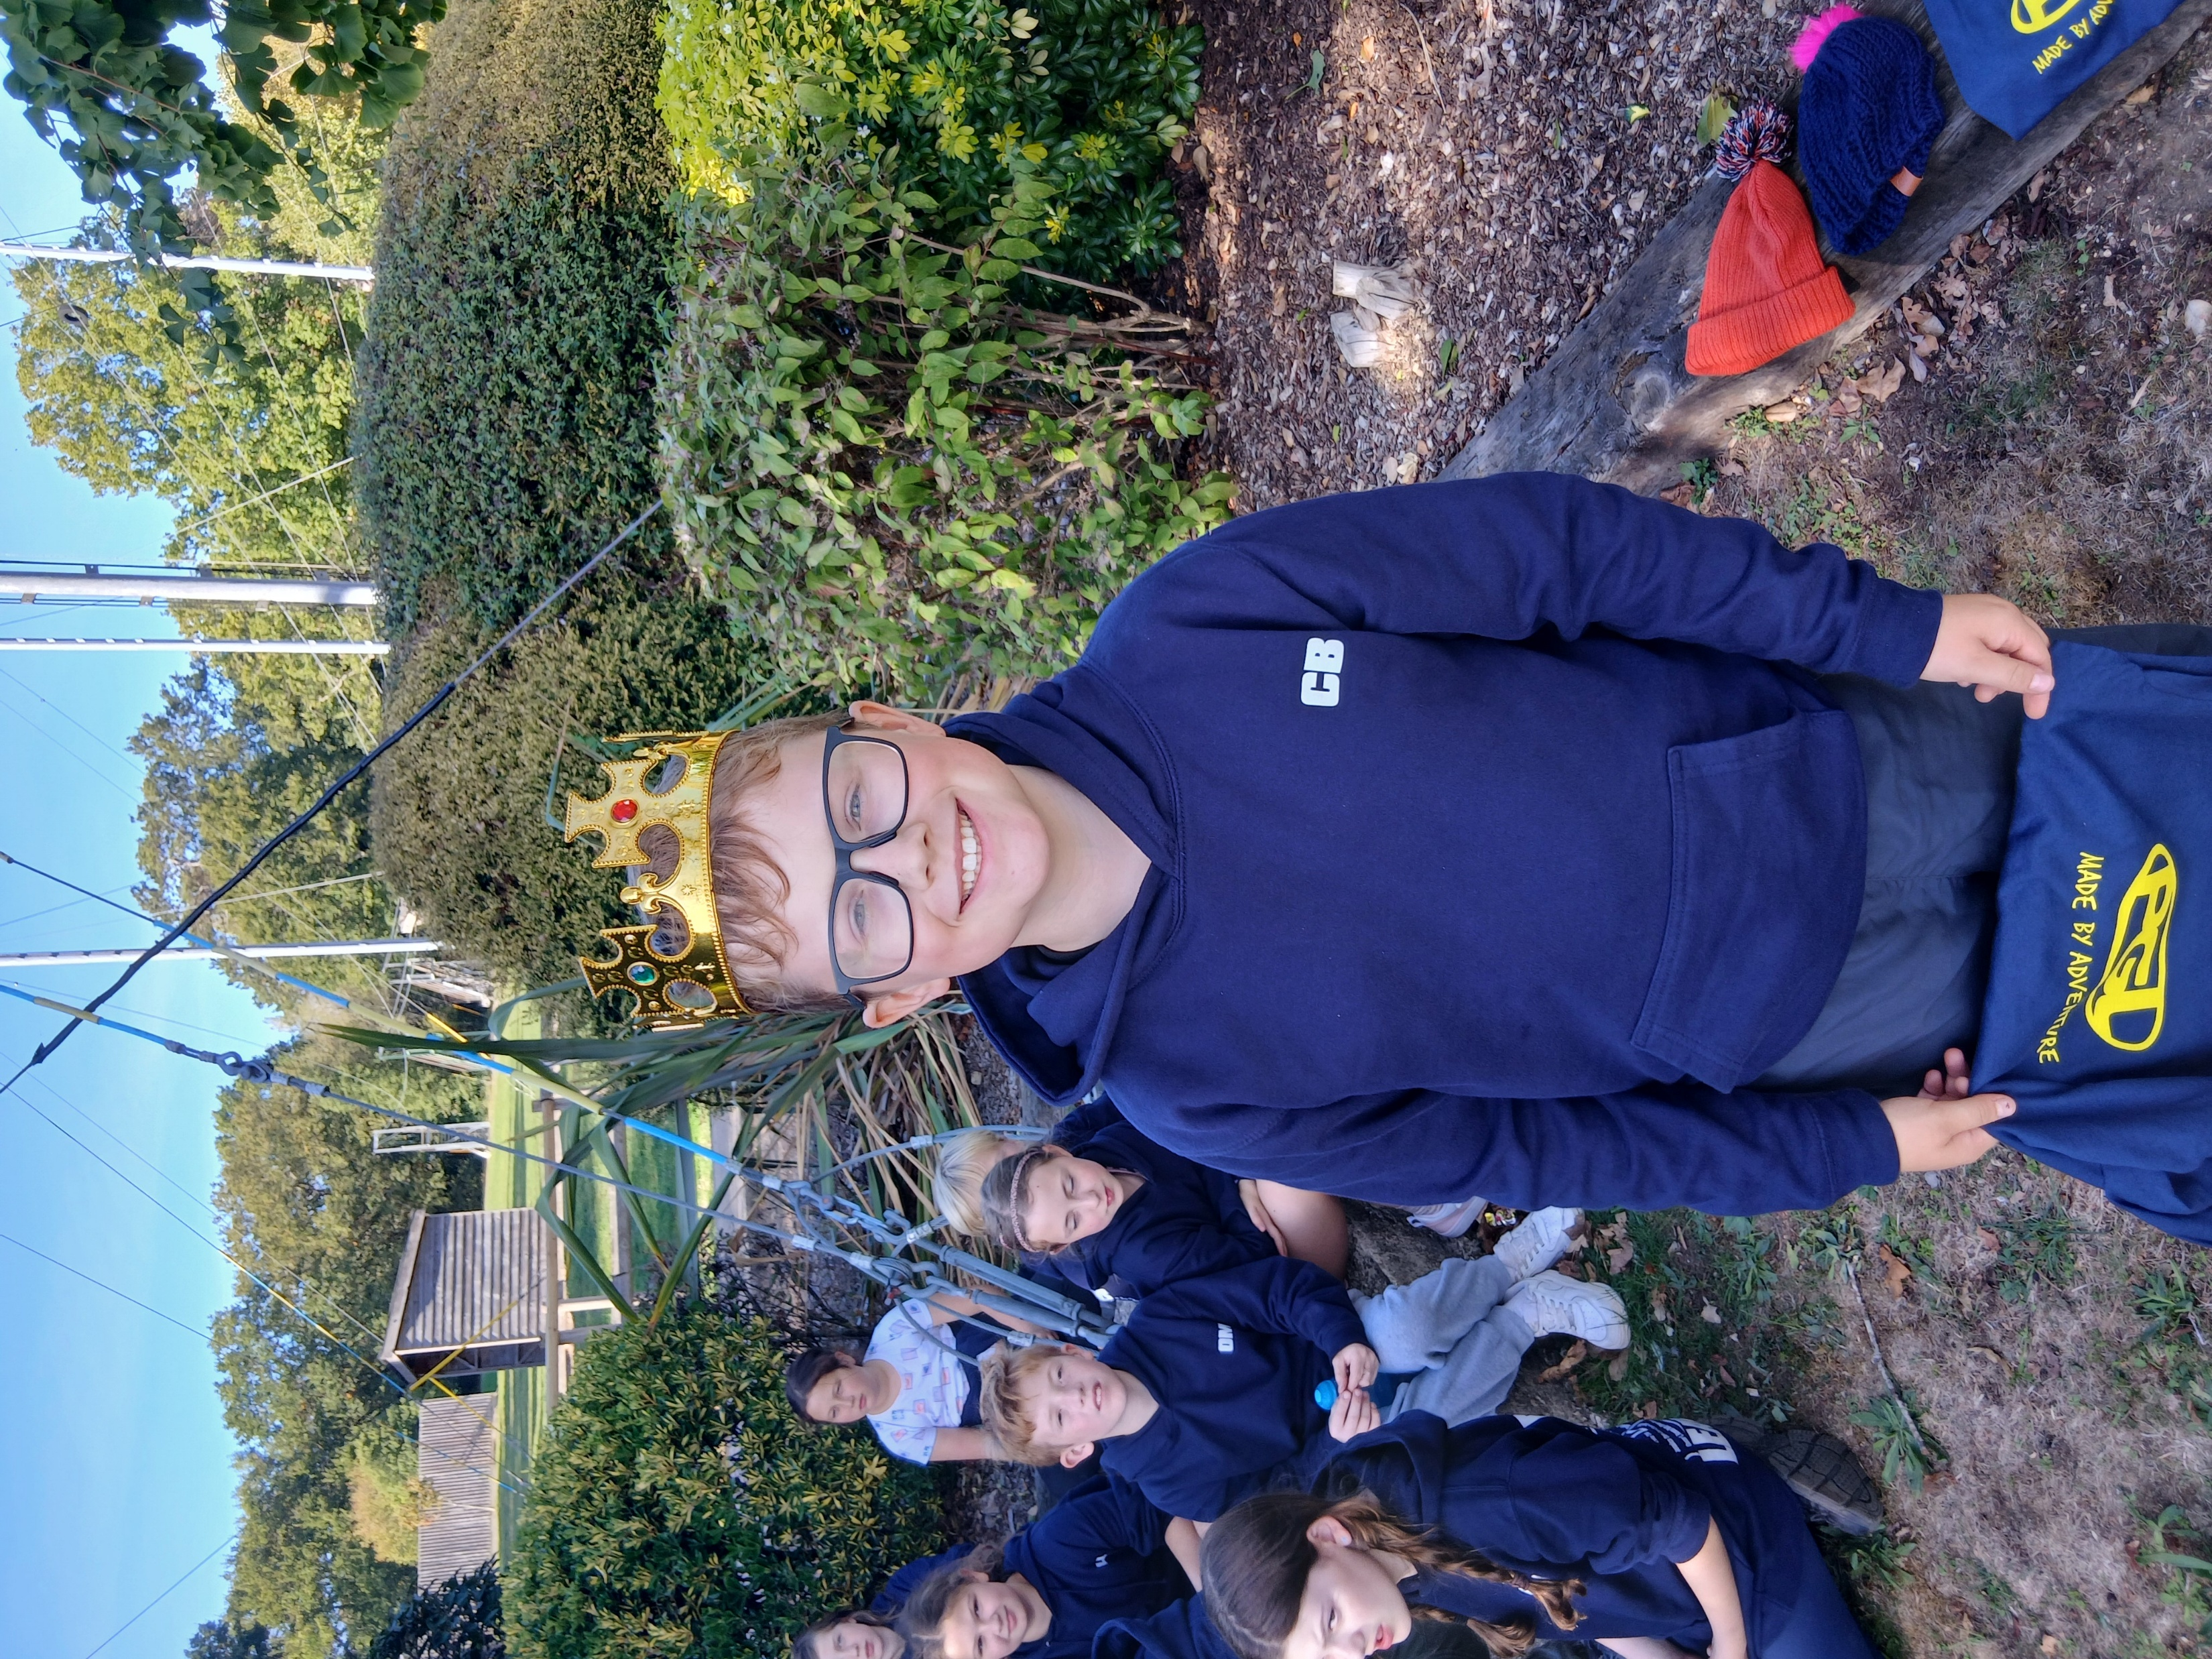
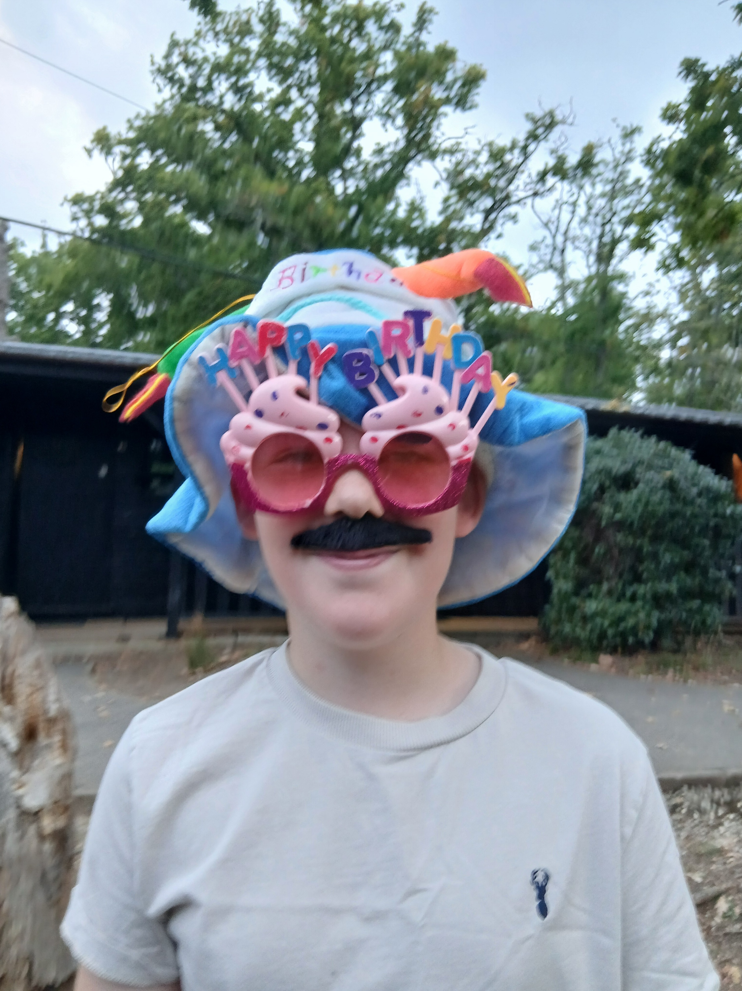
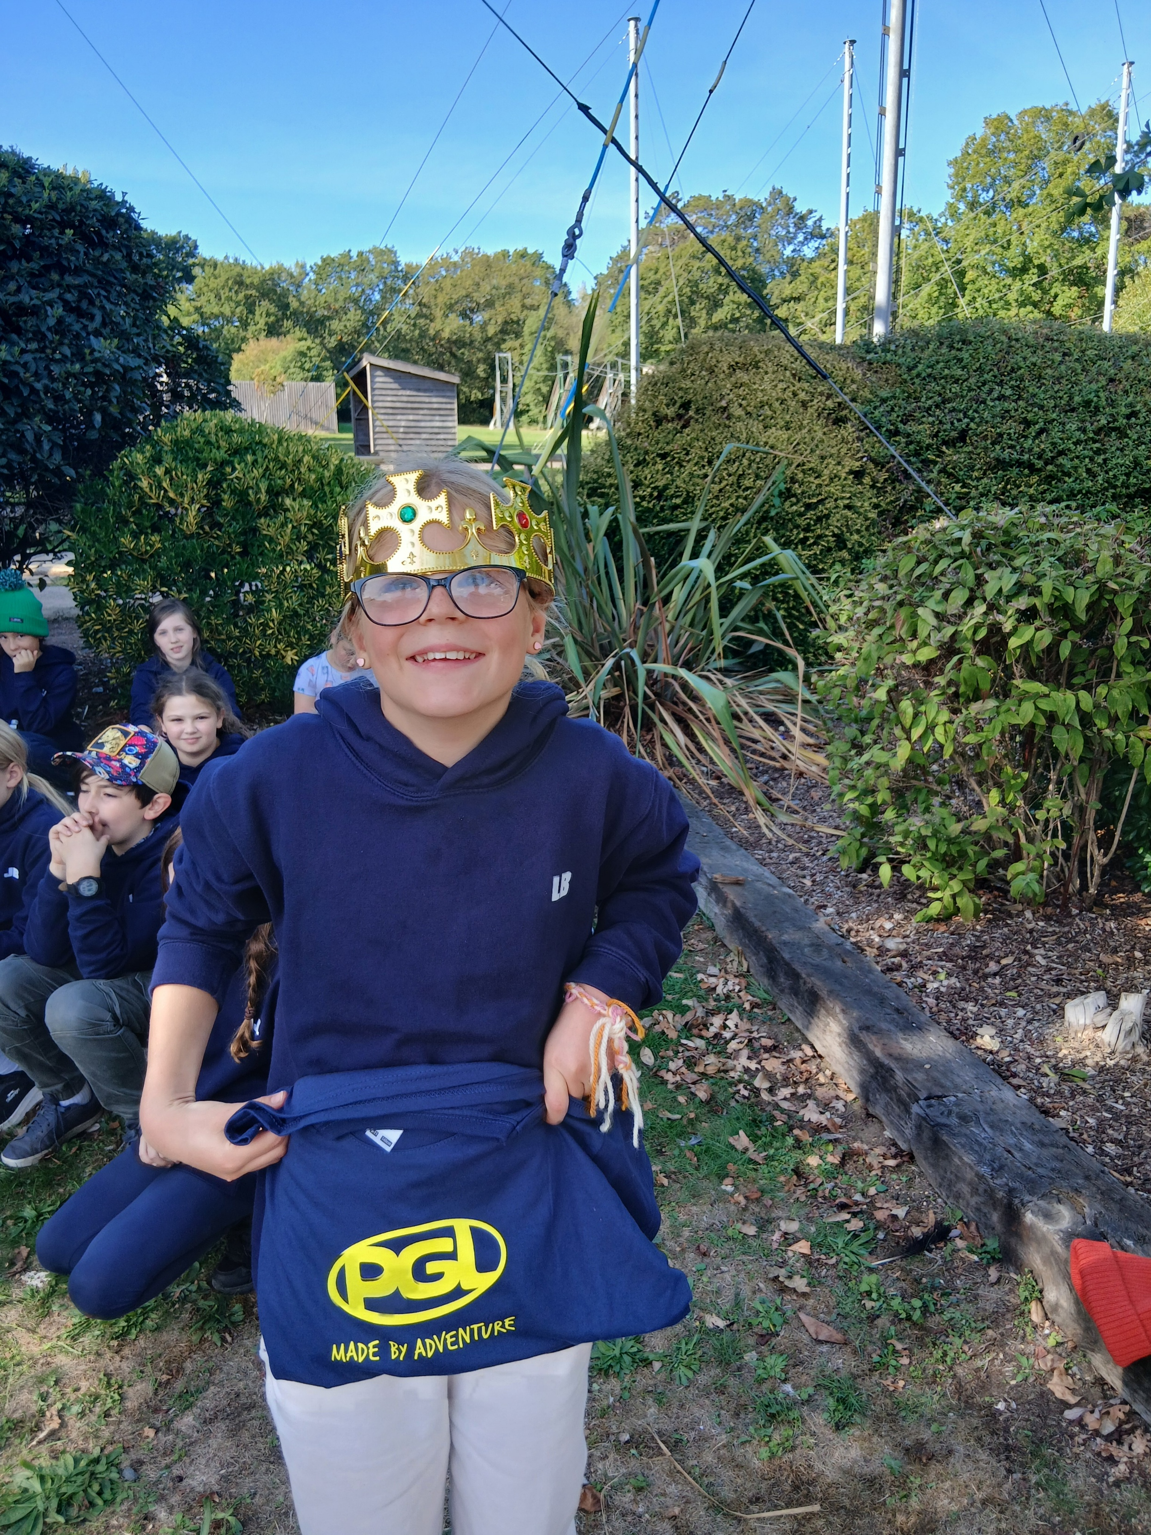
Trailblazers had a very successful residential in the Isle of Wight at Little Canada PGL centre.
They took part in 4 activities a day. Favourites were giant swing, Jacobs ladder, canoeing and axe throwing! The staff were so proud of the behaviour and positive attitude of all the children. We played bingo, had a quiz, a movie night , celebrated Wilf's birthday and had lots of competition in the evenings. Many of the instructors said Blackthorns' children were so polite and friendly. Lila and Charlie were voted Queen and King of the IOW and Betty and Tommy the Prince and Princess. Children opened letters from their parents on the way home and also letters from themselves which they had written before they left. Were their predictions of how many socks Mrs J found when she checked the rooms correct?
Trailblazers are now writing letters to our MP making sure that school residentials are always available for children.
''100% the best time of my life,'' said Flora aged 10.
''it was an amazing learning experience,'' said Cece aged 10

Slide 5
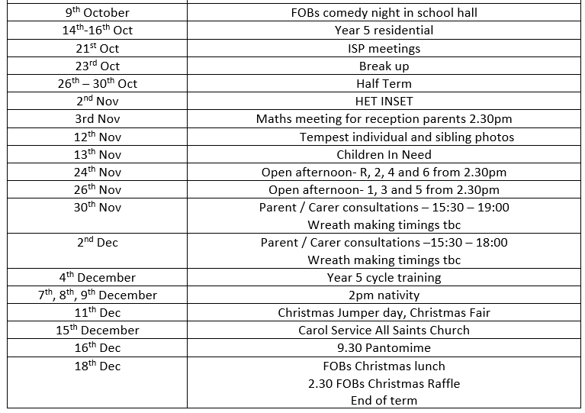
Dates for your diary. More information will follow regarding these events.
I am available at the beginning and end of the school day as much as possible, please feel free to come and speak to me should you have any queries.
EMMA SAUNDERS
Headteacher

